Slide 1
Introduction
Simplification of Boolean functions leads to simpler (and usually faster) digital circuits.
Simplifying Boolean functions using identities is time-consuming and error-prone.
This special section presents an easy, systematic method for reducing Boolean expressions.

Slide 2
Introduction
In 1953, Maurice Karnaugh was a telecommunications engineer at Bell Labs.
While exploring the new field of digital logic and its application to the design of telephone circuits, he invented a graphical way of visualizing and then simplifying Boolean expressions.
This graphical representation, now known as a Karnaugh map, or Kmap, is named in his honor.

Slide 3
Description of Kmaps and Terminology
A Kmap is a matrix consisting of rows and columns that represent the output values of a Boolean function.
The output values placed in each cell are derived from the minterms of a Boolean function.
A minterm is a product term that contains all of the function’s variables exactly once, either complemented or not complemented.

Slide 4


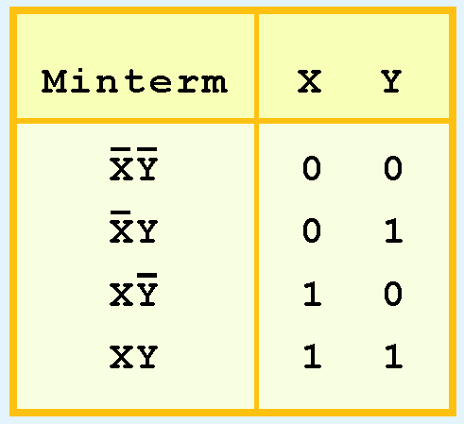
Description of Kmaps and Terminology
For example, the minterms for a function having the inputs x and y are:
Consider the Boolean function,
Its minterms are:

Slide 5
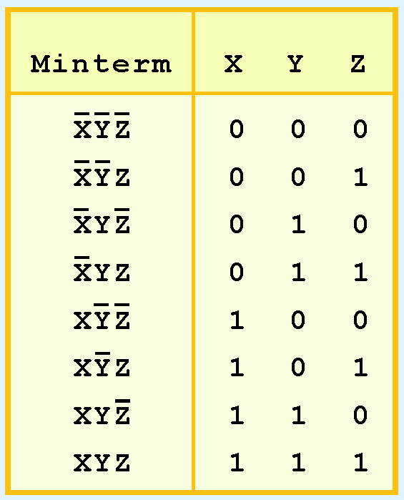
Description of Kmaps and Terminology
Similarly, a function having three inputs, has the minterms that are shown in this diagram.

Slide 6
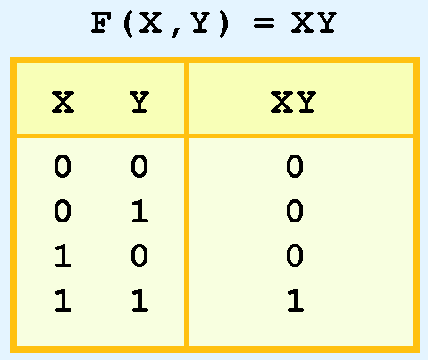
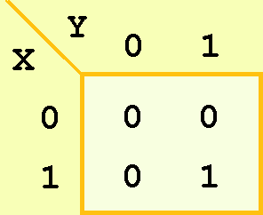
Description of Kmaps and Terminology
A Kmap has a cell for each minterm.
This means that it has a cell for each line for the truth table of a function.
The truth table for the function F(x,y) = xy is shown at the right along with its corresponding Kmap.

Slide 7
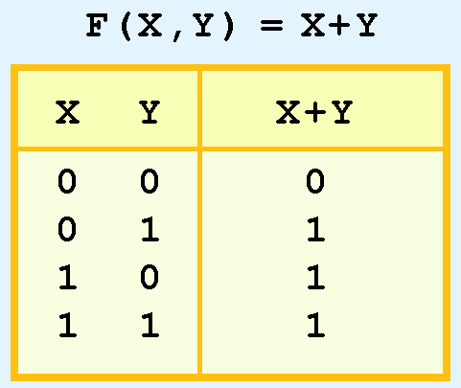
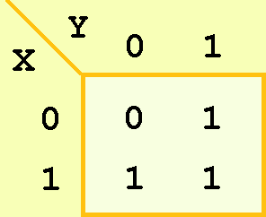
Description of Kmaps and Terminology
As another example, we give the truth table and KMap for the function, F(x,y) = x + y at the right.
This function is equivalent to the OR of all of the minterms that have a value of 1. Thus:

Slide 8
Kmap Simplification for Two Variables
Of course, the minterm function that we derived from our Kmap was not in simplest terms.
That’s what we started with in this example.
We can, however, reduce our complicated expression to its simplest terms by finding adjacent 1s in the Kmap that can be collected into groups that are powers of two.
In our example, we have two such groups.
Can you find them?

Slide 9
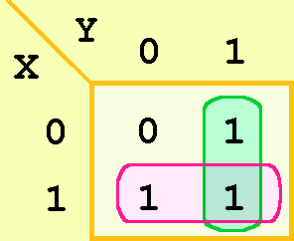
Kmap Simplification for Two Variables
The best way of selecting two groups of 1s form our simple Kmap is shown below.
We see that both groups are powers of two and that the groups overlap.
The next slide gives guidance for selecting Kmap groups.

Slide 10
Kmap Simplification for Two Variables
The rules of Kmap simplification are:
Groupings can contain only 1s; no 0s.
Groups can be formed only at right angles; diagonal groups are not allowed.
The number of 1s in a group must be a power of 2 – even if it contains a single 1.
The groups must be made as large as possible.
Groups can overlap and wrap around the sides of the Kmap.

Slide 11
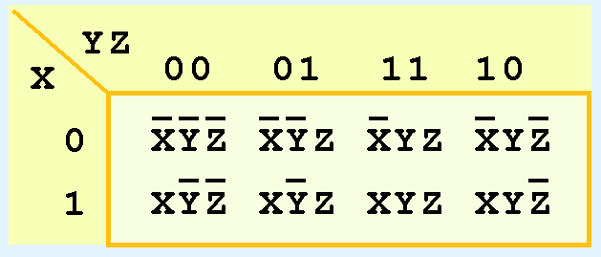
Kmap Simplification for Three Variables
A Kmap for three variables is constructed as shown in the diagram below.
We have placed each minterm in the cell that will hold its value.
Notice that the values for the yz combination at the top of the matrix form a pattern that is not a normal binary sequence.

Slide 12
Kmap Simplification for Three Variables
Thus, the first row of the Kmap contains all minterms where x has a value of zero.
The first column contains all minterms where y and z both have a value of zero.

Slide 13
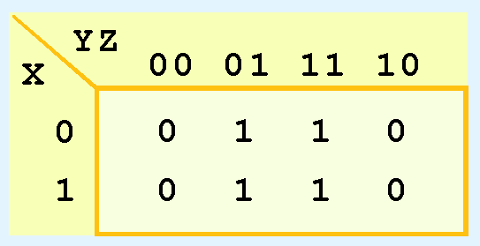
Kmap Simplification for Three Variables
Consider the function:
Its Kmap is given below.
What is the largest group of 1s that is a power of 2?

Slide 14
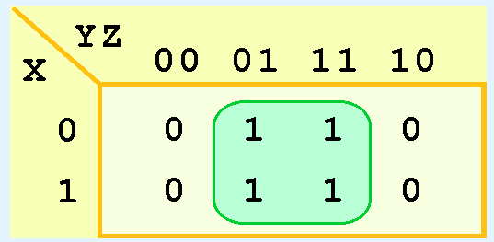
Kmap Simplification for Three Variables
This grouping tells us that changes in the variables x and y have no influence upon the value of the function: They are irrelevant.
This means that the function,
reduces to F(x) = z.
You could verify this reduction with identities or a truth table.

Slide 15
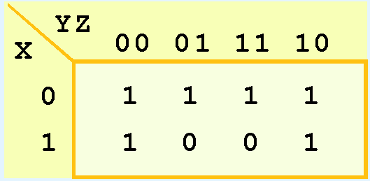
Kmap Simplification for Three Variables
Now for a more complicated Kmap. Consider the function:
Its Kmap is shown below. There are (only) two groupings of 1s.
Can you find them?

Slide 16
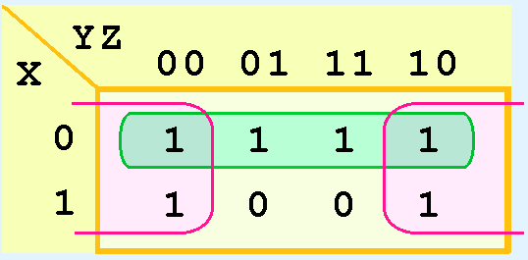
Kmap Simplification for Three Variables
In this Kmap, we see an example of a group that wraps around the sides of a Kmap.
This group tells us that the values of x and y are not relevant to the term of the function that is encompassed by the group.
What does this tell us about this term of the function?
What about the green group in the top row?

Slide 17

Kmap Simplification for Three Variables
The green group in the top row tells us that only the value of x is significant in that group.
We see that it is complemented in that row, so the other term of the reduced function is .
Our reduced function is:
Recall that we had six minterms in our original function!

Slide 18
Example
1: A’B’C+A’BC+A’BC’+AB’C’+AB’C+ABC’
2: A’B’C’+A’B’C+A’BC+AB’C

Slide 19
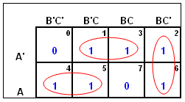
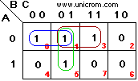
Solution:
1:A’C+BC’+AB’
2:A’B’+A’C+B’C

Slide 20
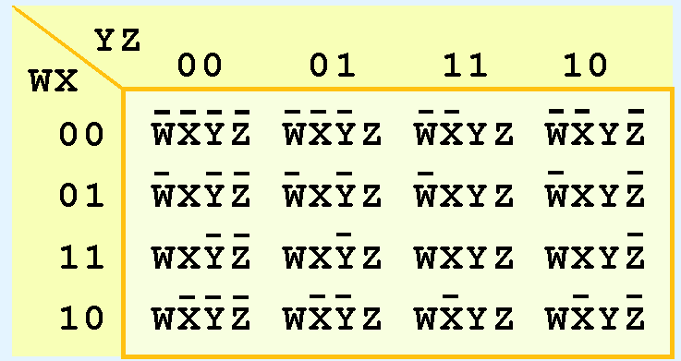
Kmap Simplification for Four Variables
Our model can be extended to accommodate the 16 minterms that are produced by a four-input function.
This is the format for a 16-minterm Kmap.

Slide 21
Summmary:
No zeros allowed.
No diagonals.
Only power of 2 number of cells in each group.
Groups should be as large as possible.
Every one must be in at least one group.
Overlapping allowed.
Wrap around allowed.
Fewest number of groups possible.

Slide 22
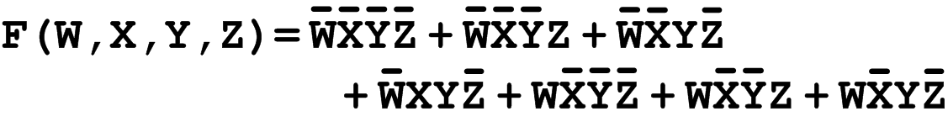
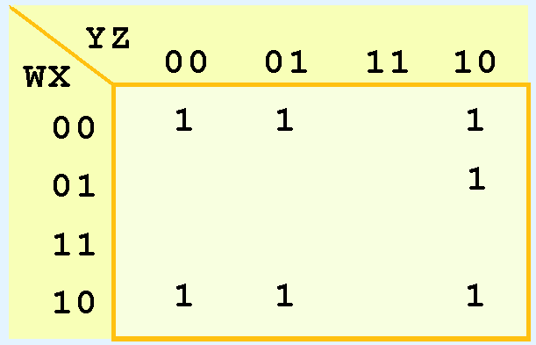
Kmap Simplification for Four Variables
We have populated the Kmap shown below with the nonzero minterms from the function:
Can you identify (only) three groups in this Kmap?
Recall that groups can overlap.

Slide 23
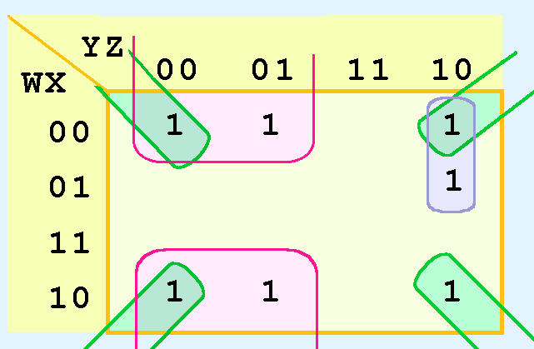
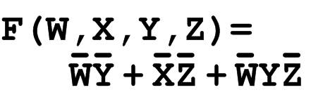
Kmap Simplification for Four Variables
Our three groups consist of:
A purple group entirely within the Kmap at the right.
A pink group that wraps the top and bottom.
A green group that spans the corners.
Thus we have three terms in our final function:

Slide 24
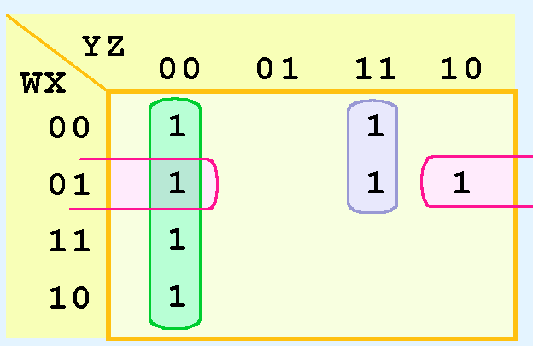
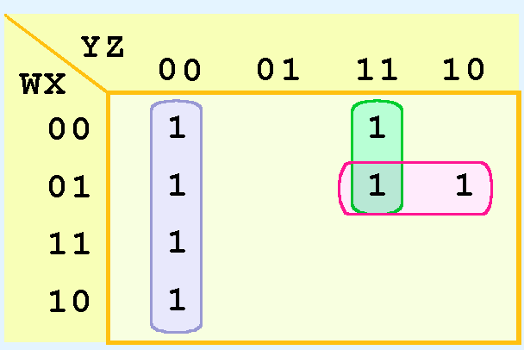
Kmap Simplification for Four Variables
It is possible to have a choice as to how to pick groups within a Kmap, while keeping the groups as large as possible.
The (different) functions that result from the groupings below are logically equivalent.

Slide 25
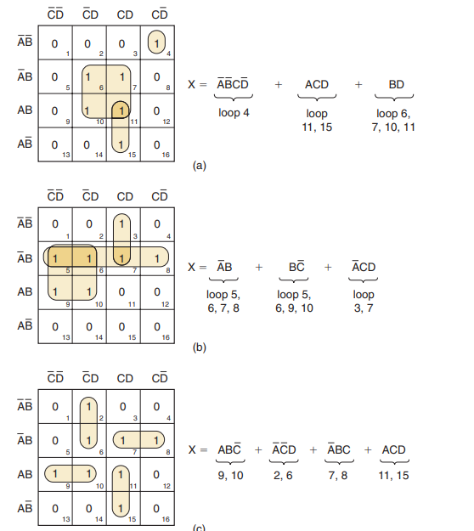

Slide 26
Don’t Care Conditions
Real circuits don’t always need to have an output defined for every possible input.
For example, some calculator displays consist of 7-segment LEDs. These LEDs can display 2 ⁷ -1 patterns, but only ten of them are useful.
If a circuit is designed so that a particular set of inputs can never happen, we call this set of inputs a don’t care condition.
They are very helpful to us in Kmap circuit simplification.

Slide 27
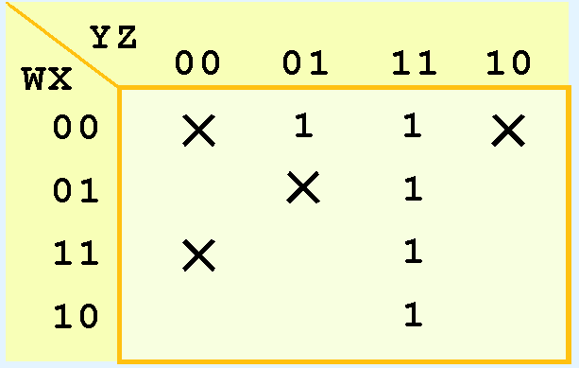
Don’t Care Conditions
In a Kmap, a don’t care condition is identified by an X in the cell of the minterm(s) for the don’t care inputs, as shown below.
In performing the simplification, we are free to include or ignore the X’s when creating our groups.

Slide 28

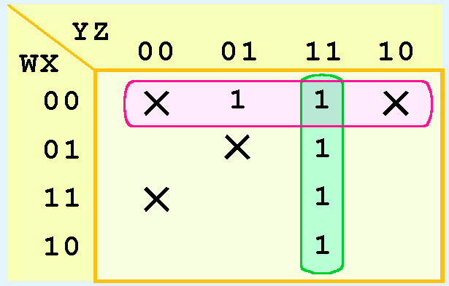
Don’t Care Conditions
In one grouping in the Kmap below, we have the function:

Slide 29

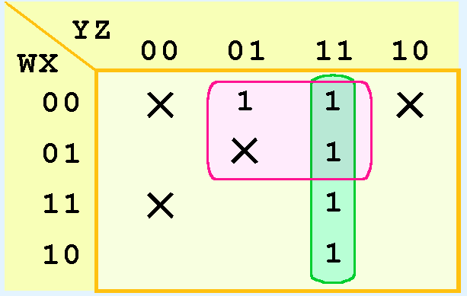
Don’t Care Conditions
A different grouping gives us the function:

Slide 30
Don’t Care Conditions
The truth table of:
differs from the truth table of:
However, the values for which they differ, are the inputs for which we have don’t care conditions.

Slide 31
Conclusion
Kmaps provide an easy graphical method of simplifying Boolean expressions.
A Kmap is a matrix consisting of the outputs of the minterms of a Boolean function.
In this section, we have discussed 2- 3- and 4-input Kmaps. This method can be extended to any number of inputs through the use of multiple tables.

Slide 32
Conclusion
Recapping the rules of Kmap simplification:
Groupings can contain only 1s; no 0s.
Groups can be formed only at right angles; diagonal groups are not allowed.
The number of 1s in a group must be a power of 2 – even if it contains a single 1.
The groups must be made as large as possible.
Groups can overlap and wrap around the sides of the Kmap.
Use don’t care conditions when you can.

Slide 33
Example 1:
F = A⋅B + A’⋅B⋅C’⋅D + A’⋅B⋅C⋅D + A⋅B’⋅C’⋅D’.

Slide 34
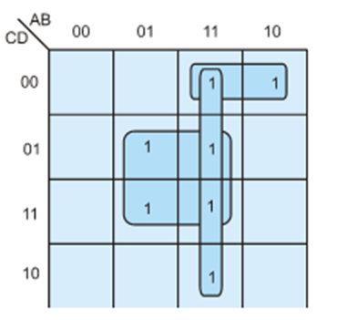
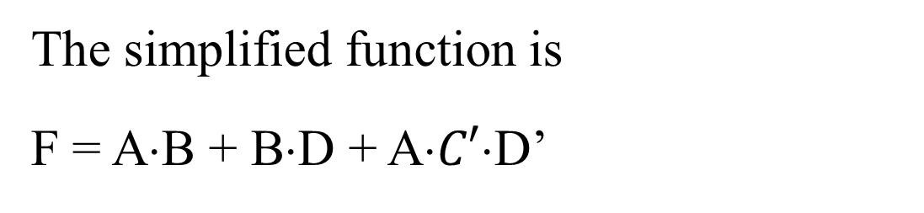
The simplified function is
F = A⋅B + B⋅D + A⋅$C′$⋅D’

Slide 35
Example 2 :
F = A⋅C’⋅D’ + A’⋅C’⋅D + A’⋅B’⋅C + A⋅B’⋅D.

Slide 36
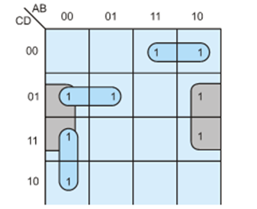

Slide 37
Example 3

Slide 38
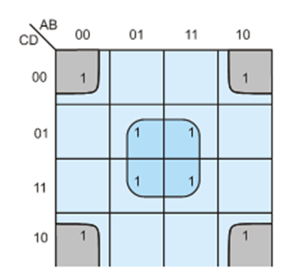

Slide 39

Example 4

Slide 40
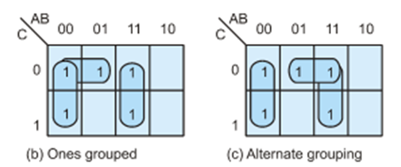

Slide 41
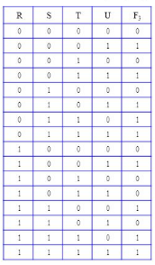
Example5:

Slide 42
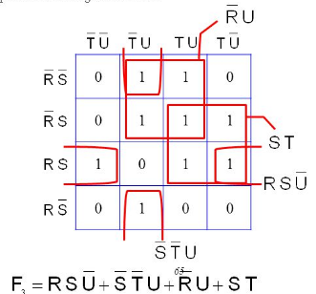
Solution:

Slide 43

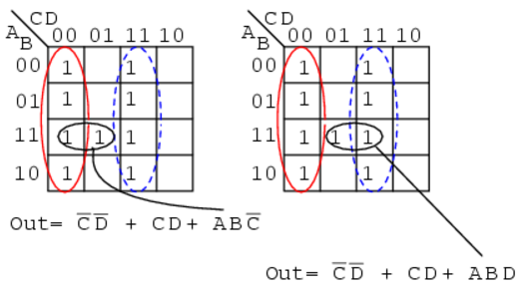
Example 6:

